Slide 1


Computer
Fundamentals
- Understanding Computer Basics -
By: Yasiru Prabodha
ID: CL/OTHMFL3/11/90

Slide 2
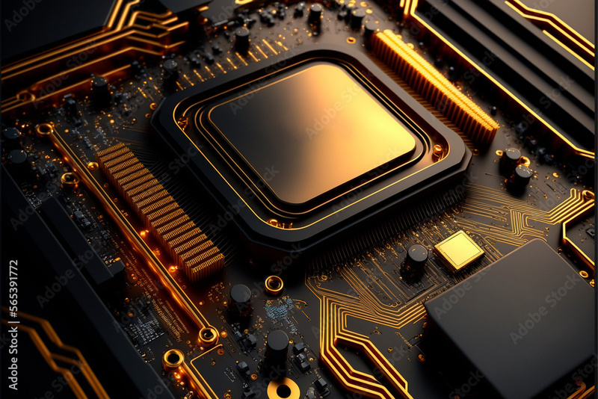
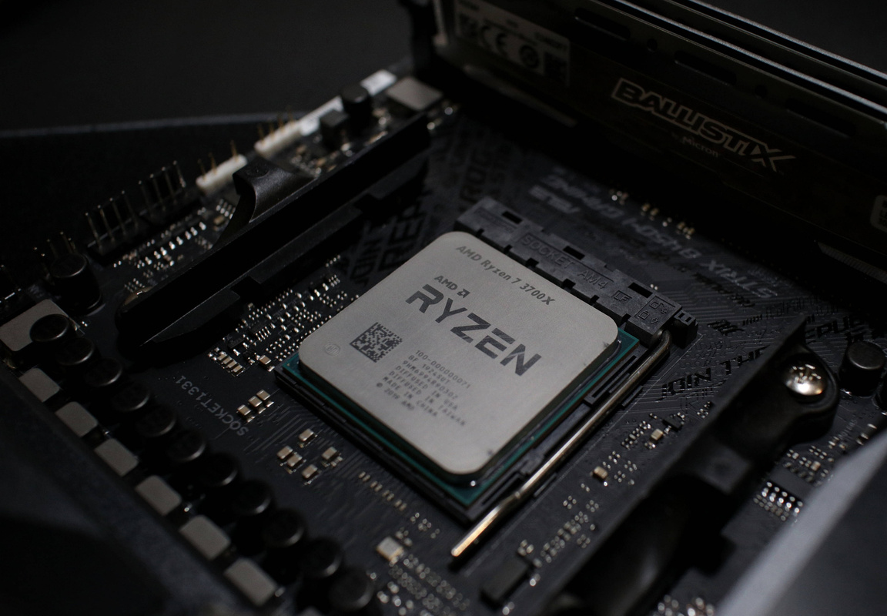
WHAT IS A CPU ?
The Central Processing Unit (CPU) is a computer's primary component that executes instructions and performs calculations. It interprets and executes instructions from computer programs by retrieving, decoding, and executing them. The speed and efficiency of a computer's processor have a considerable impact on its overall performance and responsiveness.

Slide 3
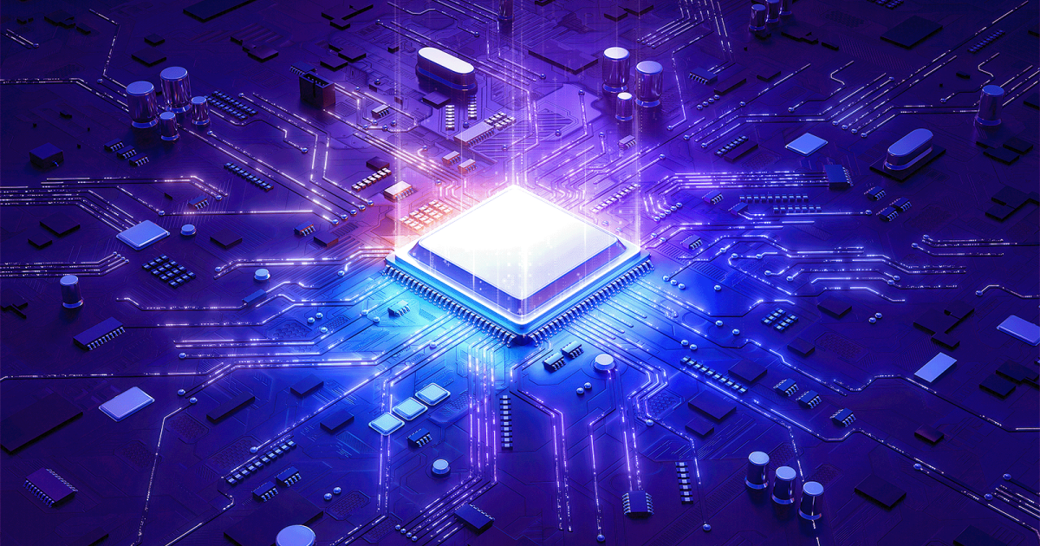
FUNCTIONS OF A CPU
Execute instructions and manage data processing activities. It loads instructions from memory, decodes them, performs operations, and stores the results. The CPU's functions include arithmetic computations, logic operations, and regulating input/output processes, coordinating these activities to ensure that the system runs smoothly.
Fetch
Decode
Execute
Store

Slide 4

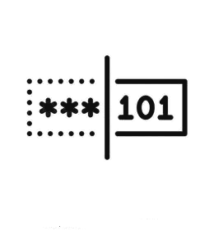
Fetch
The CPU gets program instructions from memory. These instructions are normally stored in computer memory (RAM) and executed one at a time.
Decode
When the instructions are fetched, the CPU decodes them into a format that it can understand and execute. This entails dividing the instruction into its constituent pieces and deciding what operation has to be executed.

Slide 5


Execute
The CPU executes the decoded instructions. This may include arithmetic or logical operations, data manipulation, or control flow actions like branching (making decisions based on conditions) or jumping to different portions of the program.
Store
Following execution, the operation's outcome may need to be saved in memory or in registers for further processing or output. This stage ensures that the instruction's outcome is appropriately saved for future use.

Slide 6


INTERNAL COMPONENTS OF A CPU
Control Unit (CU)
Arithmetic Logic Unit (ALU)
Registers
Cache Memory
Clock Generator
Instruction Decoder
Bus Interface Unit (BIU)
Execution Unit

Slide 7
Control Unit (CU)
Arithmetic Logic Unit (ALU)
Registers
This component directs the operation of the CPU. It fetches instructions from memory, decodes them, and executes them by coordinating the activities of other components.
The ALU performs arithmetic and logical operations, such as addition, subtraction, AND, OR, and NOT. It's the "number cruncher" of the CPU.
Registers are small, high-speed storage locations within the CPU used to temporarily hold data, instructions, and addresses. Examples include the program counter (PC), instruction register (IR), and general-purpose registers.

Slide 8
Cache Memory
Clock Generator
Instruction Decoder
Cache memory is a small amount of very fast memory located within or very close to the CPU. It stores frequently accessed data and instructions to speed up processing.
The clock generates electronic pulses at a constant rate, regulating the timing of operations within the CPU and synchronizing the activities of its components.
This component interprets the instructions fetched from memory by the control unit and directs the appropriate actions within the CPU to execute those instructions.

Slide 9
Bus Interface Unit (BIU)
Execution Unit
The BIU manages the communication between the CPU and other components of the computer system, including memory, input/output devices, and other peripherals.
This unit performs the operations specified by the instructions fetched from memory, using the ALU, registers, and other resources as needed.

Slide 10

COMPUTER HARDWARE COMPONENTS
Central Processing Unit (CPU)
Memory (RAM)
Storage Devices
Motherboard
Input Devices
Output Devices
Expansion Cards
Power Supply Unit (PSU)
Cooling Systems

Slide 11
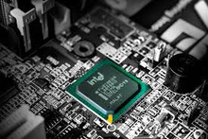
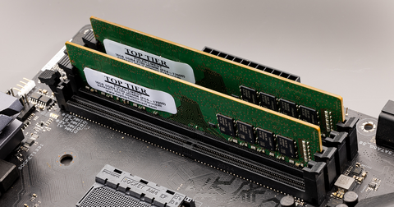
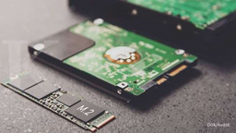



Central Processing Unit (CPU)
Memory (RAM)
Storage Devices
The CPU executes instructions by fetching, decoding, and executing them. It communicates with other components via the motherboard, exchanging signals for coordinated operation.
RAM stores data and instructions temporarily for quick access by the CPU. The CPU fetches needed information from RAM to execute programs and process data efficiently.
Storage devices like HDDs, SSDs, and optical drives store data permanently. The CPU accesses programs and files by reading from and writing to these devices. The operating system loads programs from storage into RAM for execution.

Slide 12
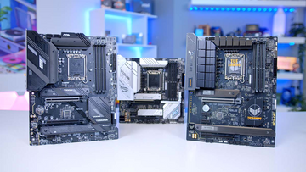

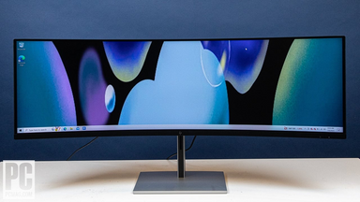



Motherboard
Input Devices
Output Devices
The motherboard connects hardware components, facilitating communication and power distribution. It links the CPU, RAM, storage, expansion cards, and peripherals through buses and connectors.
Input devices are peripherals that allow users to provide data and commands to the computer system. These devices transmit signals to the CPU, which processes the input and executes corresponding actions.
Output devices are hardware components that display or present information processed by the computer system. They provide feedback or output to the user based on the actions performed.

Slide 13

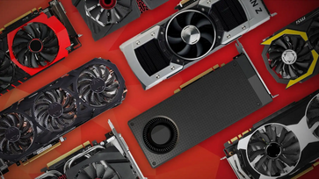
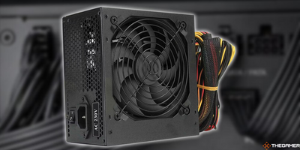

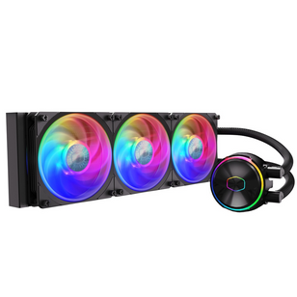

Expansion Cards
Power Supply Unit
Cooling Systems
Expansion cards like graphics, network, and sound cards boost computer performance. They have dedicated processors and memory, connecting to the CPU via the motherboard's expansion slots.
The power supply unit converts outlet electricity for computer components. It powers CPU, motherboard, storage, expansion cards. Correct voltage ensures stability.
Cooling systems like fans, heat sinks, and liquid cooling prevent overheating by dissipating CPU, GPU, and component heat, ensuring stable system operation and longevity.

Slide 14
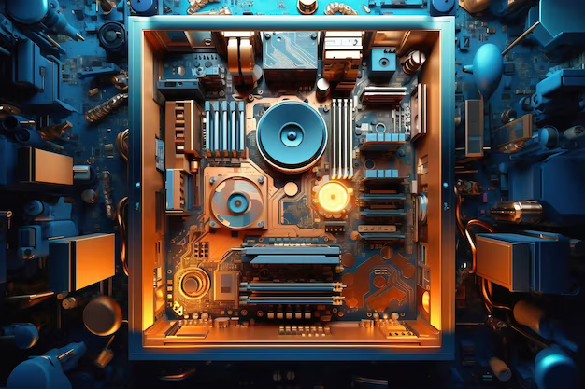
HOW COMPUTER HARDWARE COMPONENTS WORK TOGETHER
The Central Processing Unit (CPU) processes instructions and data, relying on Memory (RAM) for quick access to information. Storage Devices store data long-term. The Motherboard connects these components, along with Input Devices (like keyboards) and Output Devices (like monitors). Expansion Cards enhance capabilities, such as graphics or networking. The Power Supply Unit (PSU) provides electricity, while Cooling Systems prevent overheating. Together, these components form a cohesive system where data flows from storage to RAM, processed by the CPU, and displayed or interacted with through input and output devices. Expansion cards and cooling systems augment functionality and maintain optimal performance.

Slide 15
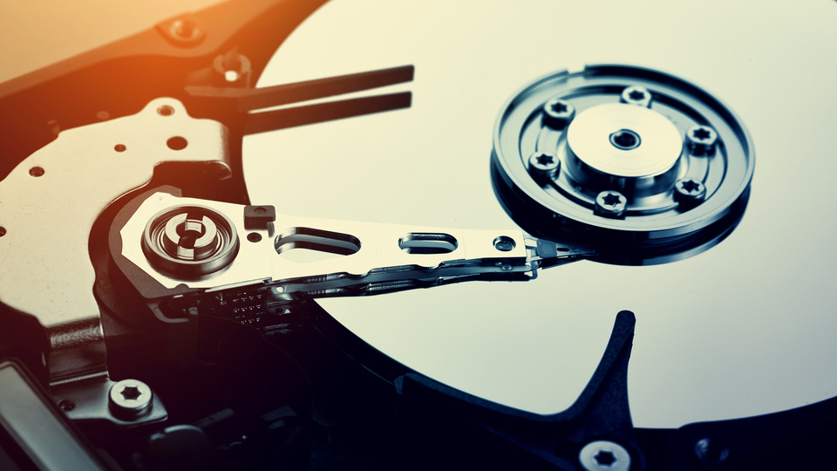
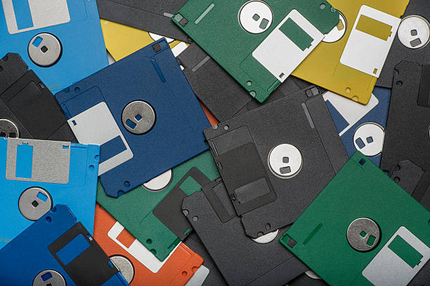
WHAT IS A STORAGE MEDIA ?
Storage media are devices, physical or digital, used for storing and retrieving data in computing and electronic systems. They serve short or long-term data retention purposes. Examples include hard disk drives, solid-state drives, USB flash drives, optical discs like CDs and DVDs, and cloud storage solutions. These mediums facilitate data management, backup, and accessibility across different devices and platforms.

Slide 16
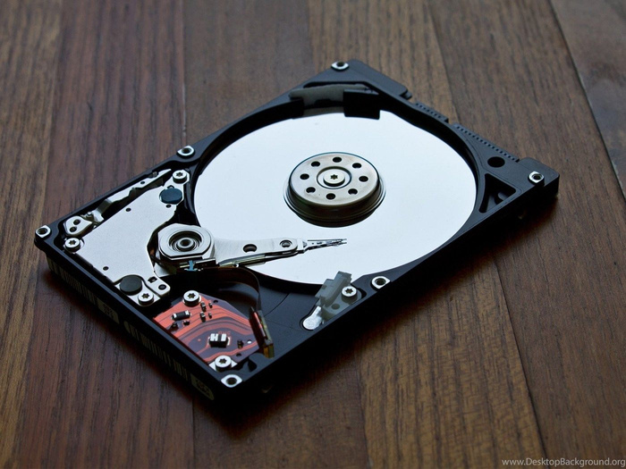
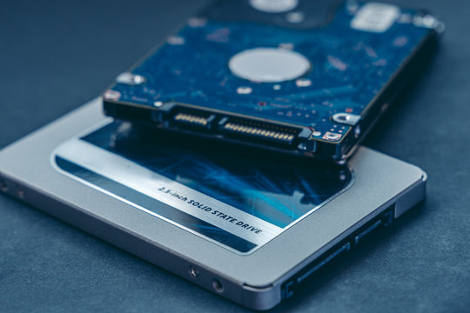
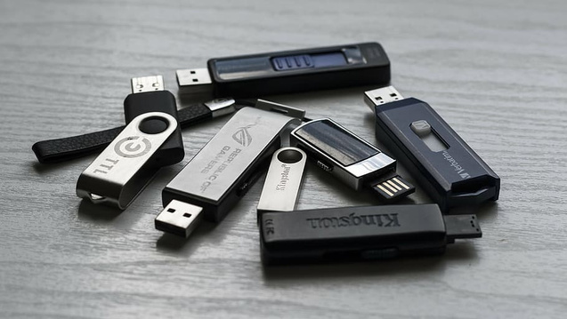
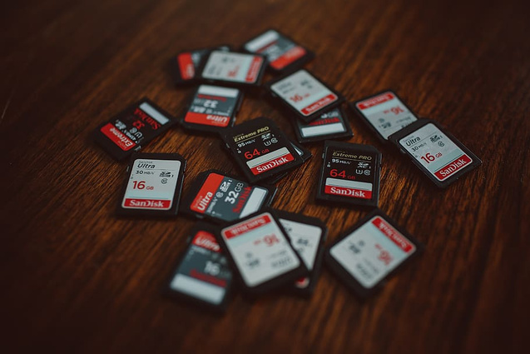
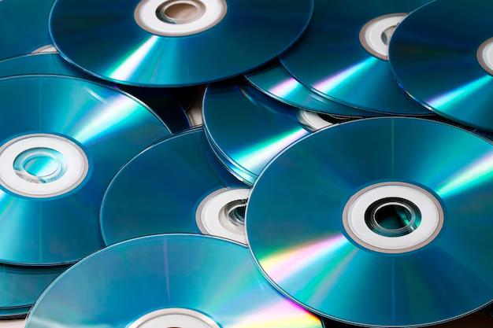

TYPES OF STORAGE MEDIA
Hard Disk Drives
Solid State Drives
Flash Drives
Memory Cards
Optical Discs
Tape Drives

Slide 17

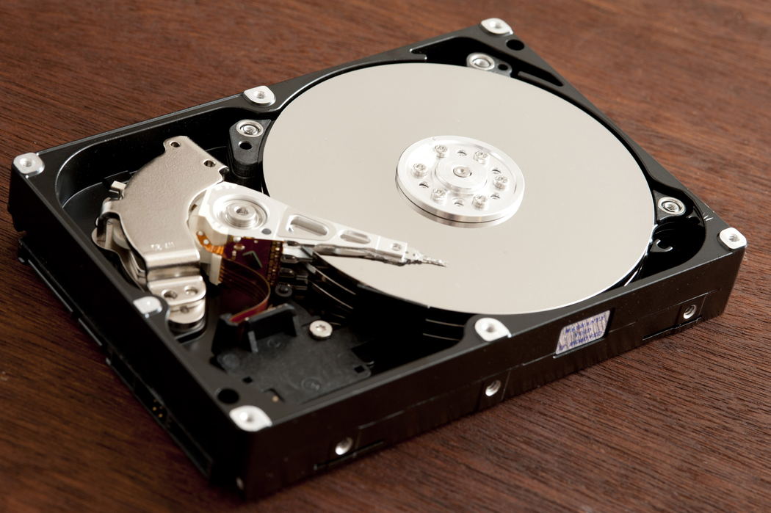
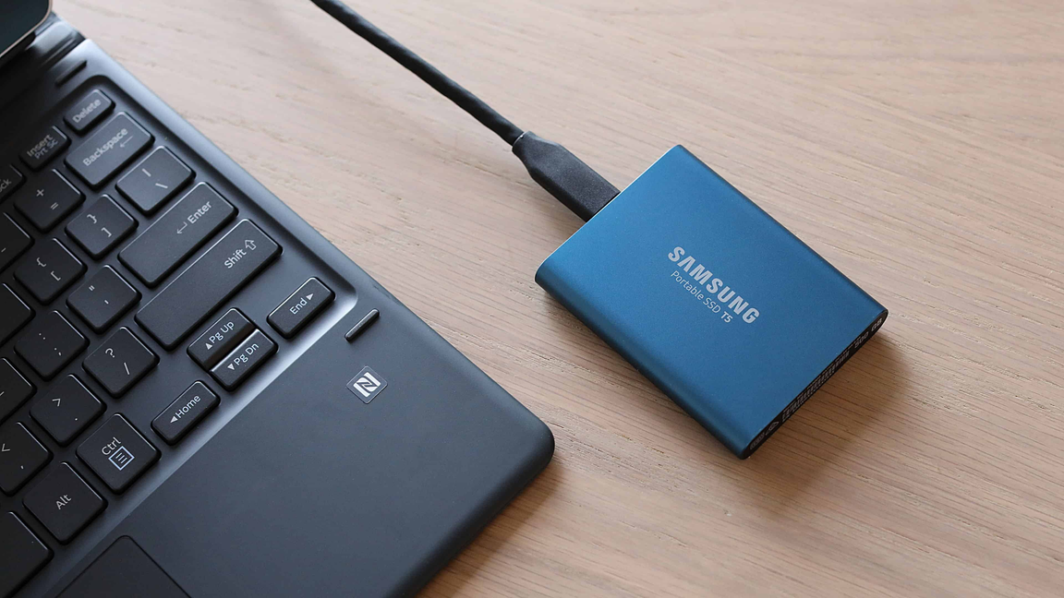
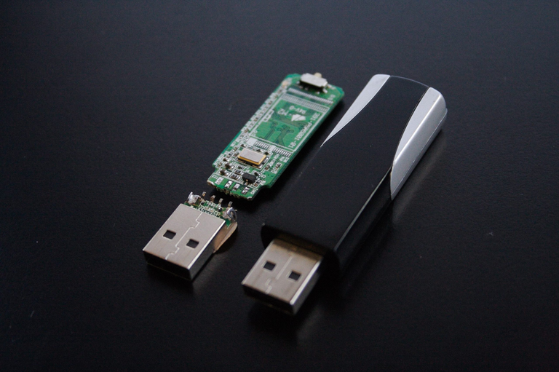
Hard Disk Drives (HDD)
Solid State Drives(SSD)
Flash Drives
Purpose : HDDs are used for long-term storage of data in computers and servers.
Purpose : SSDs offer faster data access and retrieval compared to HDDs, making them suitable for applications requiring high-speed storage.
Purpose : USB flash drives are portable storage devices used for transferring data between computers and for storing files on the go.
Use : They provide high-capacity storage at relatively lower cost per gigabyte compared to other storage media. HDDs are commonly used in desktops, laptops, servers, and data centers where large amounts of data need to be stored and accessed frequently.
Use : SSDs are used in various applications, including operating system installation, software development, gaming, and high-performance computing. They are preferred for their speed, reliability, and durability, making them ideal for use in laptops, desktops, servers, and enterprise storage systems.
Use : They are commonly used for data backup, file transfer, and portable storage. USB flash drives are convenient for transporting files between different computers and are often used by students, professionals, and individuals who need to carry data with them..

Slide 18
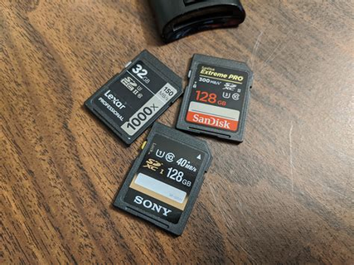
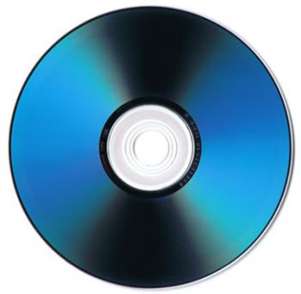
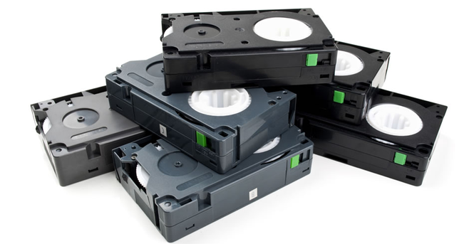
Memory Cards
Optical Discs
Tape Drives
Purpose : Memory cards are used primarily in digital cameras, smartphones, and other portable devices to store photos, videos, music, and other multimedia files.
Purpose : Optical discs are used for archival storage and distribution of data, music, movies, and software.
Purpose : Tape drives are used for long-term backup and archival storage of large volumes of data.
Use : CDs, DVDs, and Blu-ray discs are commonly used for distributing software, movies, music albums, and games. They are also used for backing up data and archiving files for long-term storage. Optical discs are suitable for situations where data needs to be stored offline and accessed infrequently.
Use : Tape drives offer high-capacity storage at a relatively low cost per gigabyte, making them suitable for backup and archival purposes in enterprise environments. They are commonly used by businesses, government agencies, and research institutions for data backup, disaster recovery, and compliance requirements.
Use : Memory cards provide expandable storage for devices with limited internal storage capacity. They are commonly used by photographers, videographers, and smartphone users to store large amounts of media files.

Slide 19
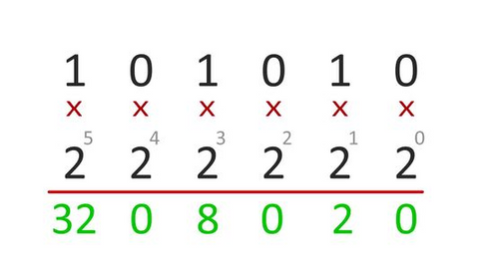
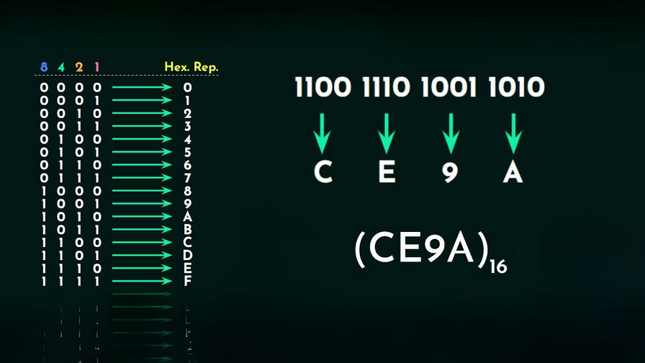
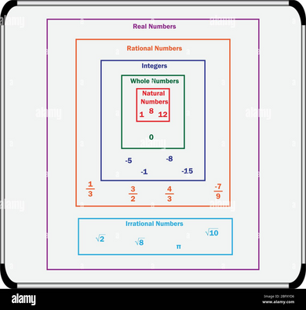
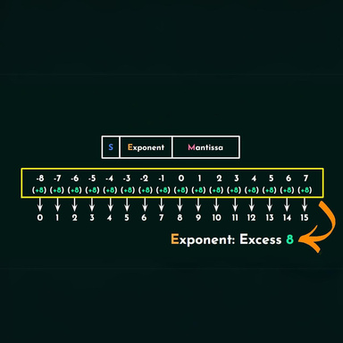
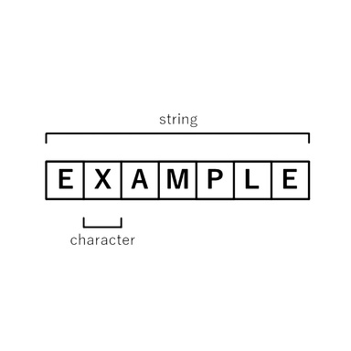
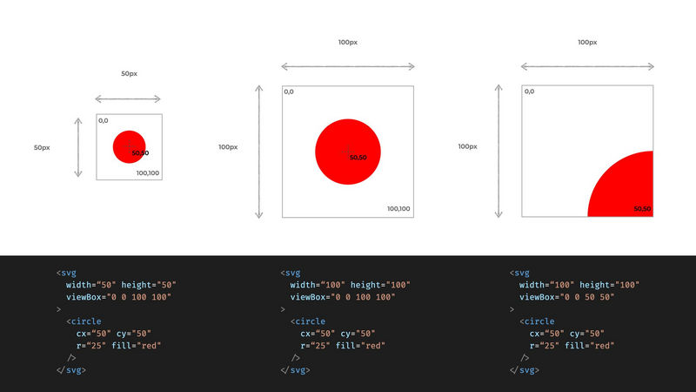
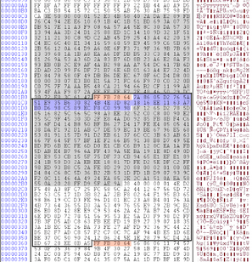
HOW DATA IS REPRESENTED IN COMPUTER SYSTEMS ?
Data in computer systems is represented in binary format, which means it's encoded using combinations of 0s and 1s. This binary system is the fundamental language of computers because it aligns with the on/off states of electronic switches within hardware components like transistors
BINARY
HEXADECIMAL
INTEGER
FLOATING POINT
CHARACTER
IMAGES
AUDIO

Slide 20
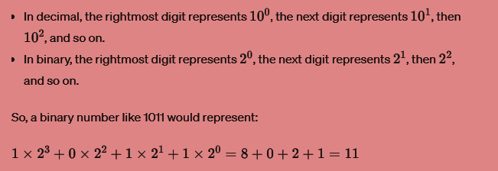
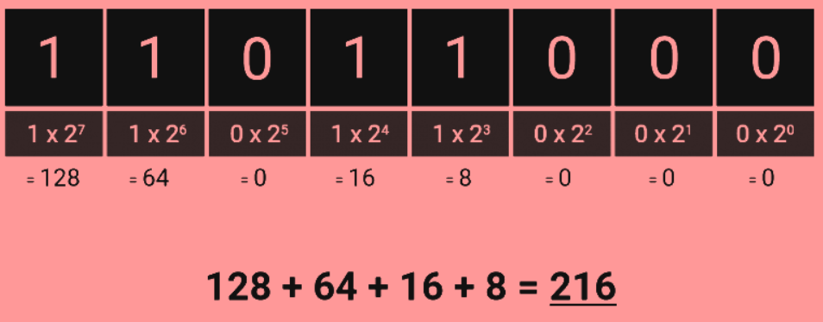
BINARY
Binary is a base-2 numbering system used in mathematics and digital electronics. Unlike the decimal system, which is base-10 and uses ten digits (0 through 9), binary uses only two digits (0 and 1).
Each digit in a binary number represents a power of 2, starting from the rightmost digit and increasing by one for each subsequent digit.

Slide 21
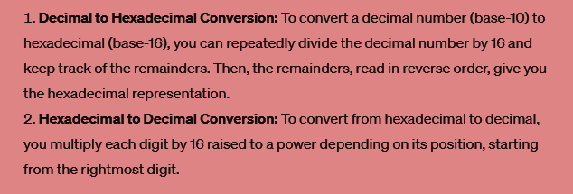
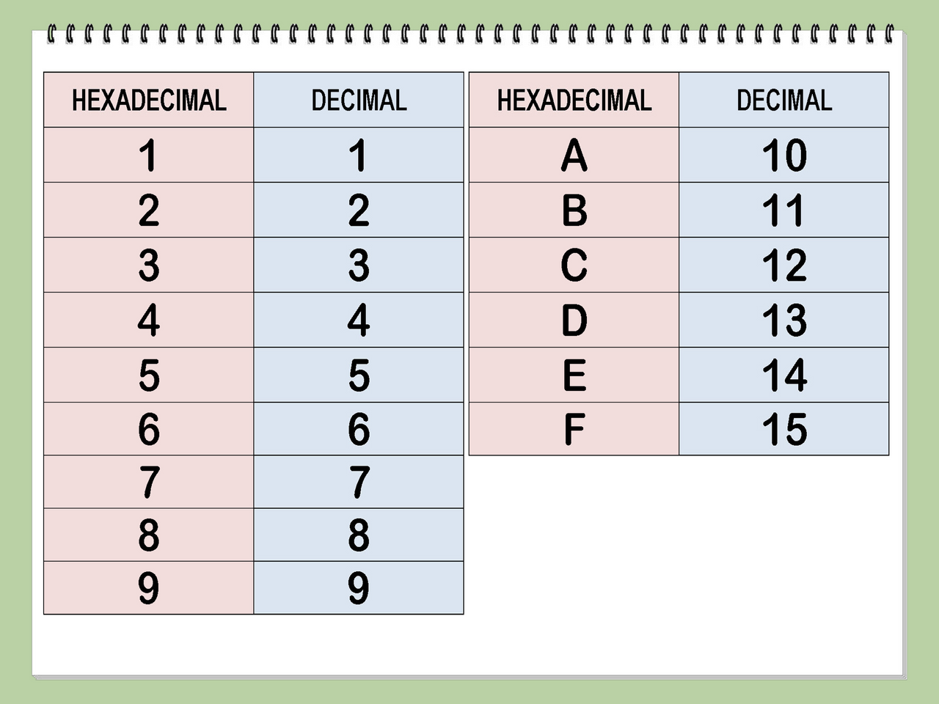
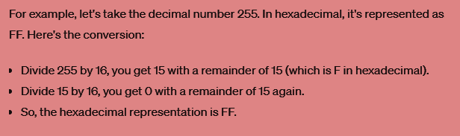
HEXADECIMAL
Hexadecimal is a base-16 numbering system commonly used in computing. It's a way of representing numbers using 16 different symbols: 0-9 for values 0 to 9, and A-F for values 10 to 15.

Slide 22
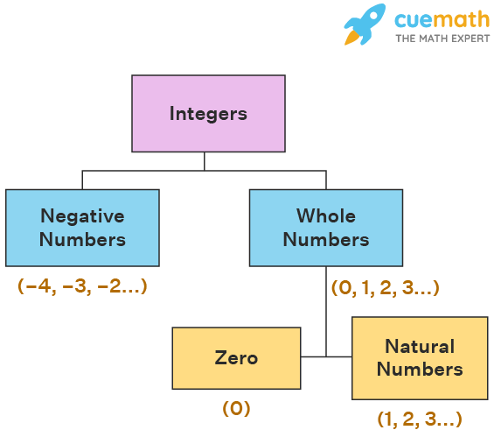
INTEGER
An integer is a whole number that doesn't include fractions or decimals. In mathematical terms, integers are the set of numbers that includes zero, positive whole numbers (1, 2, 3, ...), and negative whole numbers (-1, -2, -3, ...). Essentially, integers are the numbers you use when you're counting things, and they can be represented on the number line without any breaks or gaps. They're a fundamental concept in mathematics and are used in various calculations and equations across different fields.

Slide 23
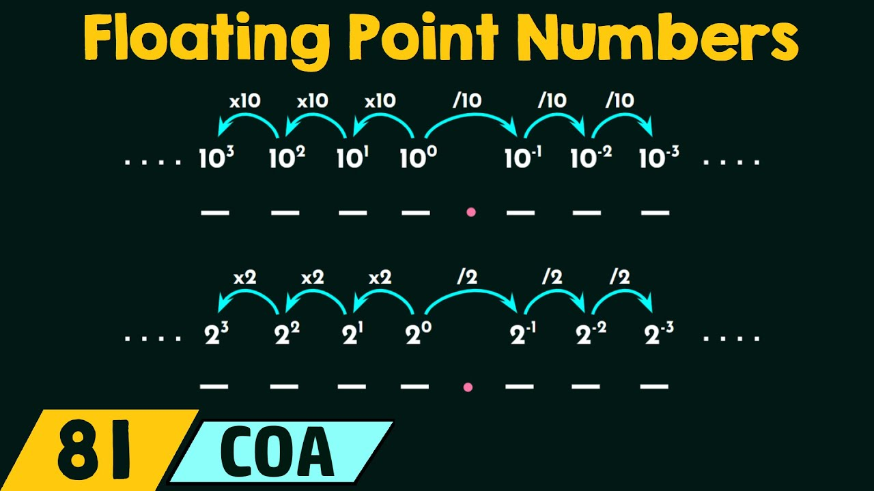
FLOATING POINT
In computing, floating point refers to a method used to represent real numbers (those that can have a fractional part) in a way that balances precision and range. It's particularly useful when dealing with numbers that can vary greatly in magnitude or require high precision.

Slide 24
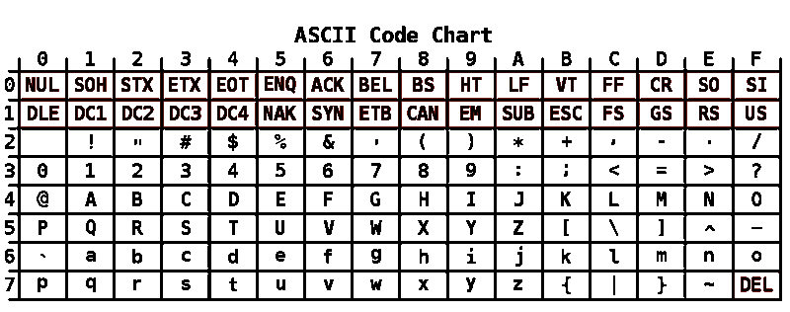
CHARACTER
Character encoding schemes like ASCII or Unicode assign unique binary codes to each character, facilitating text representation and processing by computers.

Slide 25

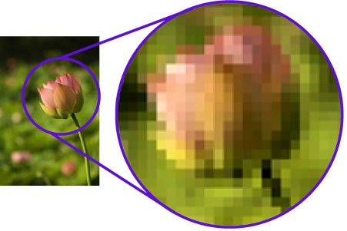
IMAGES
Images are encoded in binary data, with formats like BMP, JPEG, PNG, and GIF. Pixels' colors are defined by bits, forming the image's composition.

Slide 26
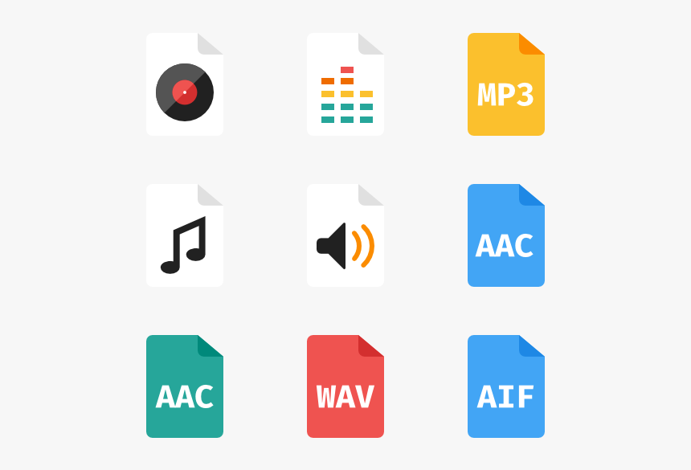
AUDIO
Audio data is captured in binary form through sampling sound wave amplitudes at regular intervals. Formats like WAV, MP3, AAC, and FLAC are commonly used. Fidelity and quality are determined by factors such as bit depth and sample rate.

Slide 27

DATA ENCRYPTION
Encryption is a method used to encode data in such a way that only authorized parties can access it. It involves transforming plaintext (readable data) into ciphertext (encrypted data) using an algorithm and a secret key. This process ensures that even if unauthorized parties intercept the encrypted data, they cannot decipher its meaning without the corresponding decryption key.

Slide 28
DATA
ENCRYPTION
Mitigates the risk of data breaches and unauthorized access
Only authorized parties can access the encrypted data
Cannot be modified or tampered with without detection
Secure data stored on various devices and platforms
facilitates secure communication and data exchange across
borders
DATA
DECRYPTION

Slide 29
Plaintext
Encryption Algorithm
Encryption Key
Original unencrypted data to be protected, like a message or file.
Encryption algorithms are mathematical procedures that transform plaintext into ciphertext, making it hard to decipher without the decryption key.
The Encryption Key is a critical element in encryption, modifying the algorithm's behavior to ensure unique ciphertext outputs. Kept secret, it's only known to authorized parties.
Decryption
Ciphertext
Security
Decryption is reversing encryption, converting ciphertext to plaintext using the decryption key, enabling understanding of the original data.
The ciphertext, gibberish in appearance, encrypts plaintext data making it indecipherable without the decryption key. It serves as the secured form during transmission or storage.
Encryption ensures data confidentiality and security by scrambling information in a way that only those with the decryption key can understand it, protecting sensitive data from interception and manipulation by malicious actors.

Slide 30
REPRESENTATION OF IMAGES AND SOUNDS IN COMPUTER SYSTEMS
IMAGES
Raster Images (Bitmaps)
Vector Graphics
SOUNDS
Digital Audio
Musical Instrument Digital Interface
(MIDI)

Slide 31
Images
Raster Images (Bitmaps)
Pixel-Based: Images are made up of a grid of small squares called pixels. Each pixel has its own color value.
Color Depth: Defines the number of bits used to represent the color of each pixel (e.g., 8-bit for grayscale, 24-bit for true color).
Compression: Various algorithms are used to reduce file size without significant loss of quality (e.g. lossy compression for JPEG, lossless compression for PNG).
Formats: Common formats include JPEG, PNG, GIF, BMP, TIFF, etc.

Slide 32
Images
Vector Graphics
Shape-Based: Images are defined mathematically using points, lines, curves, and shapes.
Scalability: Vector graphics can be resized without loss of quality since they are resolution-independent.
Formats: Common formats include SVG (Scalable Vector Graphics), EPS (Encapsulated PostScript), PDF (Portable Document Format).

Slide 33
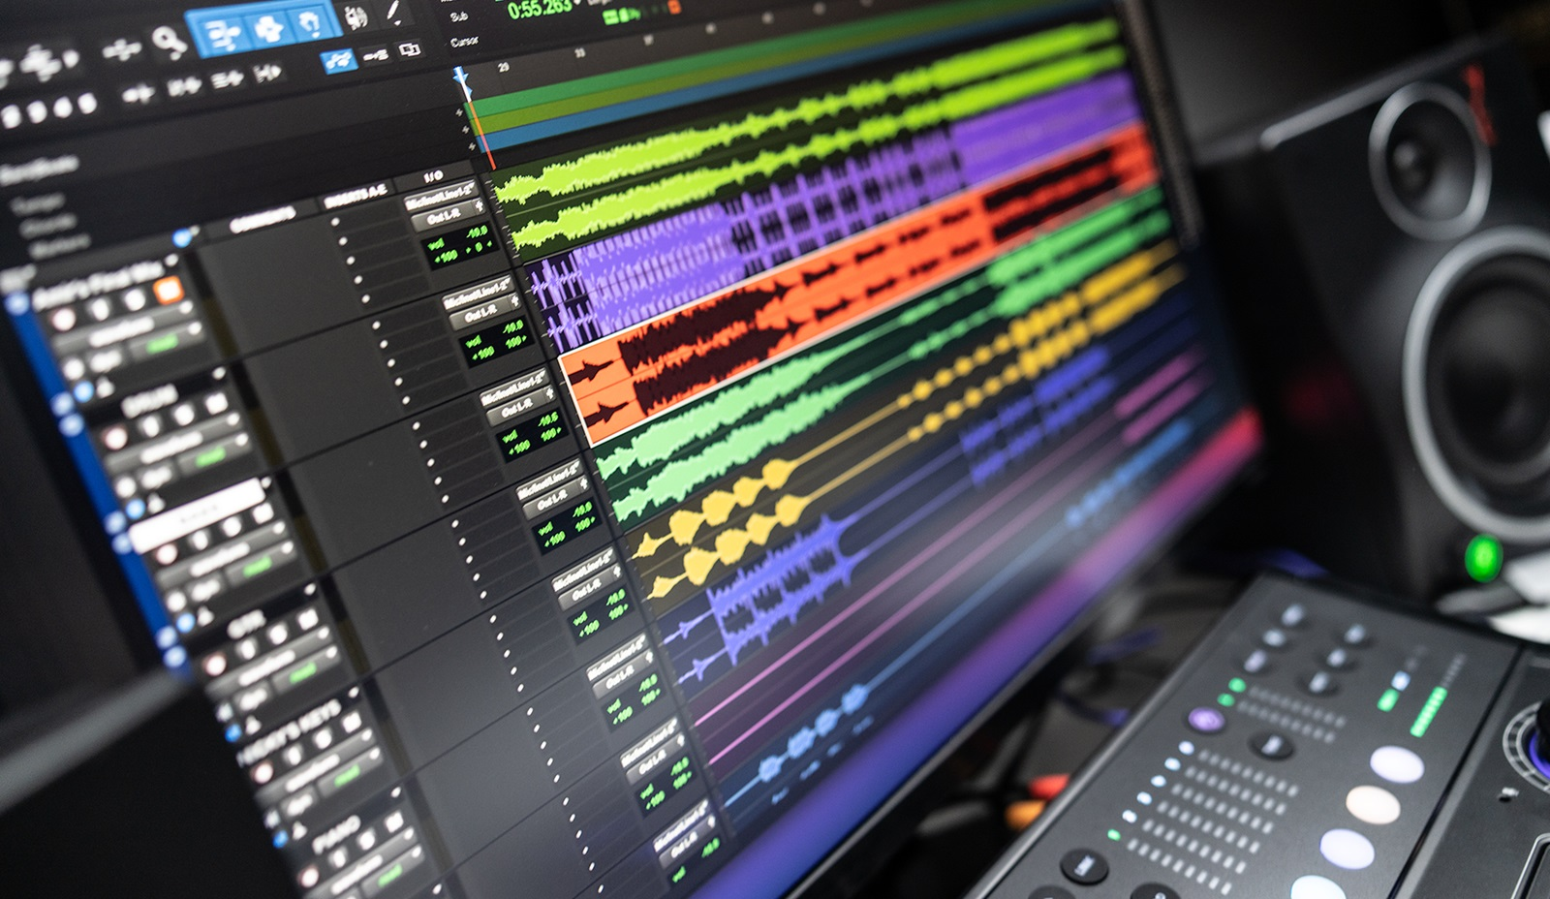
Sounds
Digital Audio
Sampled Sound: Sound is represented as a sequence of discrete samples taken from an analog waveform.
Bit Depth: Number of bits used to represent each sample's amplitude.
Sampling Rate: Number of samples per second (measured in Hertz, Hz).
Compression: Lossy and lossless compression techniques are used to reduce file size (e.g., MP3, AAC, FLAC).
Formats: Common formats include WAV, AIFF, MP3, AAC, FLAC, OGG, etc.

Slide 34
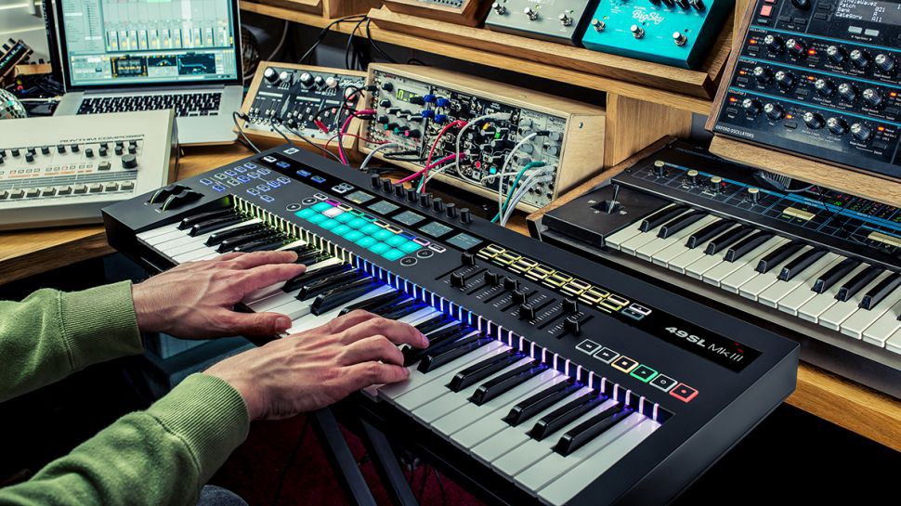
Sounds
MIDI (Musical Instrument Digital Interface)
Event-Based: MIDI data represents musical notes, pitch, duration, and other parameters rather than actual sound waves.
Scalability: MIDI files are small and can be easily edited without losing quality.
Formats: MIDI files typically have a .mid extension.

Slide 35

OPTIMIZING DATA STORAGE EFFICIENCY THROUGH COMPRESSION TECHNIQUES
Compression is a technique used in computing to reduce the size of data, images, or sounds by removing redundant or unnecessary information while preserving the essential features.
1. Reduced Storage Space
2. Faster Data Transfer:
3. Cost Savings
4. Increased Efficiency
5. Preservation of Data Integrity
6. Facilitation of Backup and Archiving

Slide 36
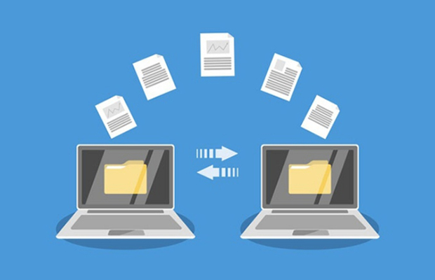
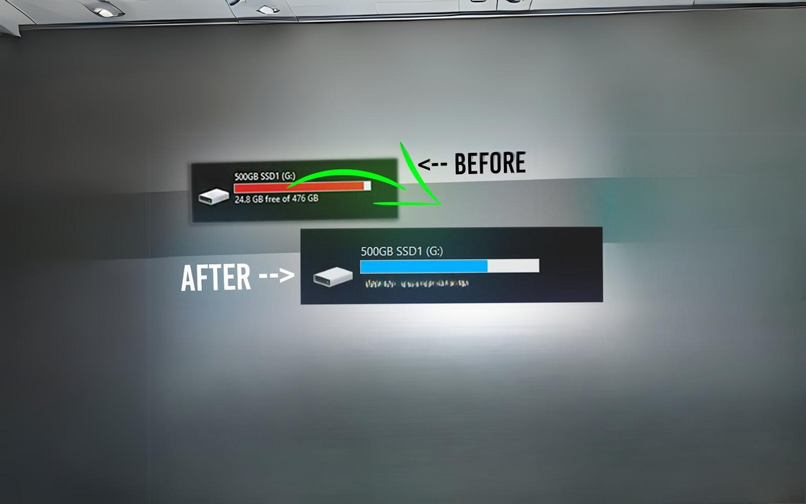

Reduced Storage Space
Cost Savings
Compression significantly reduces the overall size of files, requiring less storage space compared to their uncompressed counterparts. This is particularly advantageous when dealing with large datasets, multimedia files, or when storage capacity is limited.
Compression saves costs by reducing storage needs and speeding up data transfer, cutting expenses on infrastructure and network bandwidth.
Faster Data Transfer
Smaller file sizes resulting from compression enable quicker data transfer over networks or other communication channels. This is especially important in scenarios where bandwidth is limited or expensive.

Slide 37

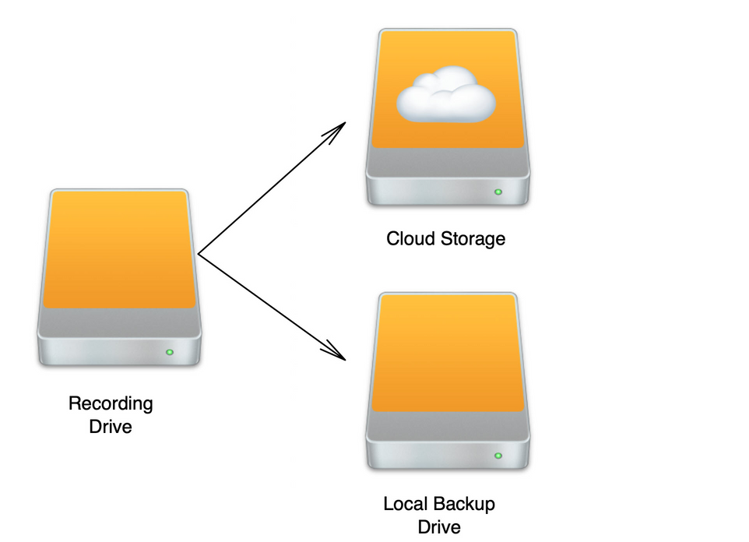
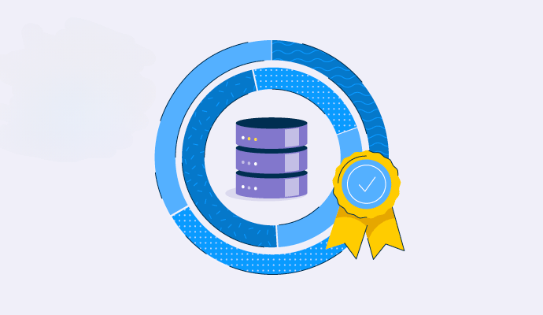
Preservation of Data Integrity
Compression maintains data integrity by preserving key features while eliminating redundancy. Effective algorithms ensure that decompressed data closely matches the original, vital for multimedia fidelity.
Increased Efficiency
Facilitation of Backup and Archiving
Compressed files optimize storage space, enhancing system performance by reducing read/write time. They're processed faster, aiding data retrieval and manipulation.
Compressed files simplify backup and archiving by reducing storage needs and speeding up data transfer, making the processes more efficient.

Slide 38
LOGIC GATES
Logic gates are fundamental building blocks of digital circuits, performing logical operations on one or more binary inputs to produce a single binary output. These gates are crucial in digital electronics and computer science for processing and manipulating binary data. The purpose of logic gates is to implement Boolean functions, which represent logical relationships between binary variables.
AND Gate
OR Gate
NOT Gate
NAND Gate
NOR Gate
XOR Gate
XNOR Gate
The purpose of logic gates is to process binary information according to predefined logical rules, enabling the manipulation and transformation of digital data. Each logic gate performs a specific logical operation based on the input values it receives and produces an output accordingly.

Slide 39
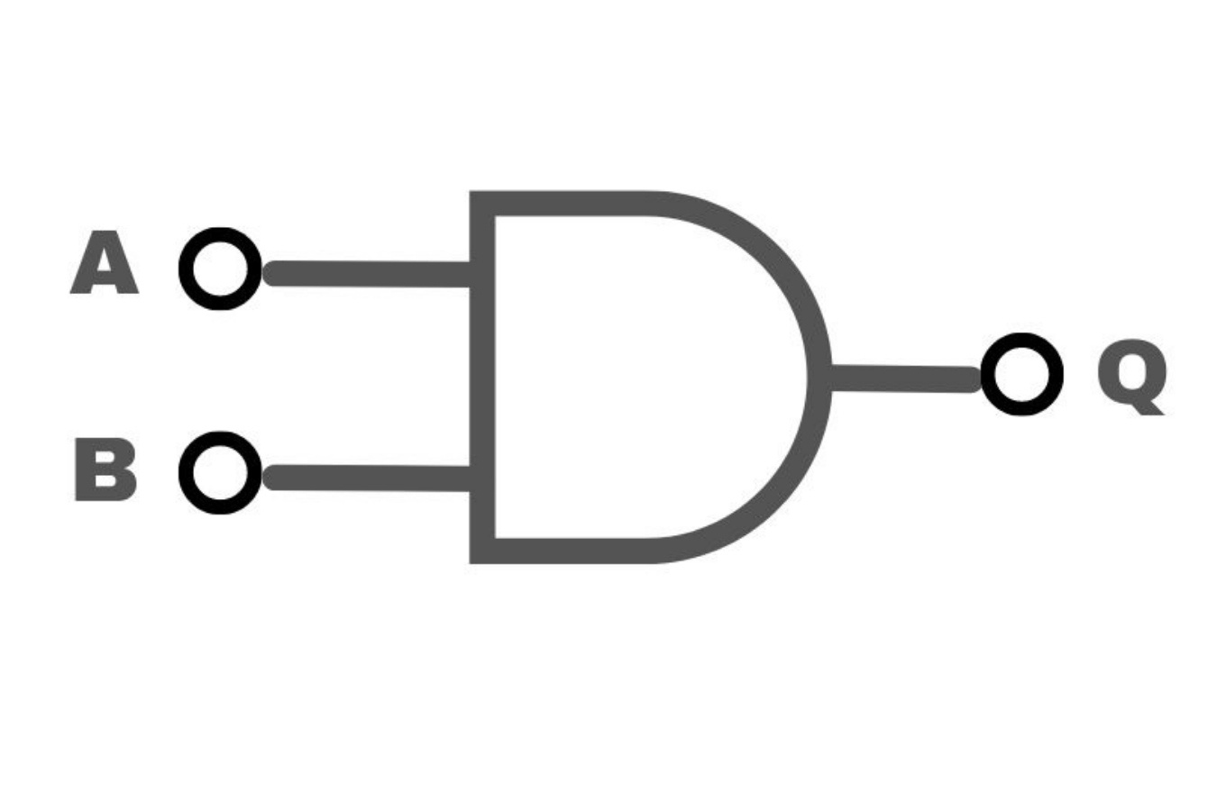
AND GATE
Truth Table
A | B | Q(OUT)
0 | 0 | 0
0 | 1 | 0
1 | 0 | 0
1 | 1 | 1
Outputs a high (1) signal only when all of its inputs are high (1). Otherwise, it outputs a low (0) signal. Its purpose is to perform the logical AND operation.

Slide 40

OR GATE
Truth Table
A | B | OUT
0 | 0 | 0
0 | 1 | 1
1 | 0 | 1
1 | 1 | 1
Outputs a high (1) signal if any of its inputs are high (1). It outputs a low (0) signal only when all of its inputs are low (0). Its purpose is to perform the logical OR operation.

Slide 41

NOT GATE(Inverter)
Truth Table
A | OUT
0 | 1
1 | 0
Outputs the opposite value of its input. If the input is high (1), the output is low (0), and vice versa. Its purpose is to perform the logical NOT operation.

Slide 42


NAND GATE
Truth Table
A | B | Z(OUT)
0 | 0 | 1
0 | 1 | 1
1 | 0 | 1
1 | 1 | 0
Outputs a low (0) signal only when all of its inputs are high (1). Otherwise, it outputs a high (1) signal. It is essentially an AND gate followed by a NOT gate.

Slide 43


NOR GATE
Truth Table
A | B | Z(OUT)
0 | 0 | 1
0 | 1 | 0
1 | 0 | 0
1 | 1 | 0
The NOR gate produces a LOW output (0) if any of its inputs are HIGH (1) otherwise, it produces a HIGH output (1). It is essentially a OR gate followed by a NOT gate.

Slide 44

XOR GATE
Truth Table
A | B | OUT
0 | 0 | 0
0 | 1 | 1
1 | 0 | 1
1 | 1 | 0
Outputs a high (1) signal if any of its inputs are high (1). It outputs a low (0) signal only when all of its inputs are low (0). Its purpose is to perform the logical OR operation.

Slide 45

XNOR GATE
Truth Table
A | B | OUT
0 | 0 | 1
0 | 1 | 0
1 | 0 | 0
1 | 1 | 1
Outputs a high (1) signal if its inputs are the same (both high or both low). It outputs a low (0) signal if its inputs are different (one high and one low). It is essentially an XOR gate followed by a NOT gate.

Slide 46
COMPUTER NETWORK
Types of computer networks
A computer network is a collection of interconnected devices that can communicate with each other and share resources. These devices, known as nodes, can include computers, servers, routers, switches, printers, and other hardware devices. The connections between these devices can be established using various communication technologies such as wired Ethernet, Wi-Fi, or cellular networks.
Local Area Network (LAN)
Wide Area Network (WAN)
Metropolitan Area Network (MAN)
Wireless LAN (WLAN)
Virtual Private Network (VPN)
The primary purpose of a computer network is to facilitate communication and resource sharing among connected devices. This enables users to access data, services, and applications from different locations within the network. Computer networks can vary in size and complexity, ranging from small local networks within a home or office to large-scale networks spanning multiple cities or countries.
Internet
Intranet
Extranet

Slide 47

Local Area Network (LAN)
LANs are used to connect devices within a limited area such as a home, office, or school. They facilitate the sharing of resources like printers, files, and internet access among connected devices. LANs are typically fast and are used for tasks requiring high speed communication between devices in close proximity.

Slide 48

Wide Area Network (WAN)
WANs connect LANs over a large geographical area, often across cities, countries, or continents. They enable communication between distant locations and are commonly used by organizations with multiple branches or offices. WANs utilize various technologies, including leased lines, satellites, and the internet, to facilitate long distance communication.

Slide 49

Metropolitan Area Network (MAN)
MANs cover a larger geographic area than LANs but smaller than WANs, typically spanning a city or metropolitan area. They provide high-speed connectivity between various locations within a city and are often used by service providers to connect multiple LANs or campuses.

Slide 50

Wireless LAN (WLAN)
WLANs use wireless communication technologies such as Wi-Fi to connect devices within a limited area without the need for physical cables. They provide flexibility and mobility, allowing devices to connect to the network without being tethered to a specific location. WLANs are commonly found in homes, offices, airports, and cafes.

Slide 51

Virtual Private Network (VPN)
VPNs create secure, encrypted connections over public networks such as the internet. They are used to establish private and secure communication channels, especially for remote access to corporate networks or for accessing the internet anonymously. VPNs ensure data confidentiality, integrity, and authenticity, making them crucial for protecting sensitive information.

Slide 52

Internet
The internet is a global network of networks that connects millions of devices worldwide. Its primary purpose is to facilitate communication and information exchange on a global scale. The internet enables access to a vast array of services, resources, and information, including websites, email, social media, online shopping, and cloud computing.

Slide 53

Intranet
An intranet is a private network that operates within an organization, typically using internet technologies such as TCP/IP protocols and web browsers. Its purpose is to facilitate internal communication, collaboration, and information sharing among employees. Intranets often host company portals, databases, documents, and internal applications accessible only to authorized users.

Slide 54

Extranet
An extranet is a controlled extension of an organization's intranet that provides limited access to external users such as partners, suppliers, or customers. Its purpose is to facilitate secure collaboration and information sharing between an organization and its external stakeholders. Extranets are commonly used for sharing documents, conducting transactions, and coordinating activities with external parties.

Slide 55
Components of Computer Networks
Computer networks encompass an array of interconnected elements, including hardware, software, and transmission media, collaborating to enable seamless communication and data transfer between devices. Understanding the distinct roles of each component is vital for grasping the intricate workings of these networks.
Hardware Components
Software Components
Transmission Media

Slide 56


Hardware Components
Network Interface Cards (NICs)
These are physical devices that allow computers to connect to a network. NICs facilitate the transmission and reception of data between devices.
Switches
Acting as intermediaries, switches facilitate communication within a network by directing data packets to their intended destinations. They operate at the data link layer of the OSI model.

Slide 57



Routers
Responsible for forwarding data packets between different networks, routers make decisions about the optimal path for data transmission based on network conditions.
Modems
These devices modulate and demodulate digital signals to enable communication over analog transmission media such as telephone lines.
Cables and Connectors
Ethernet cables, fiber optic cables, and various connectors form the physical infrastructure of a network, enabling the transmission of data between devices.

Slide 58



Software Components
Network Operating Systems (NOS)
Protocol Suites
Network Management Software
These specialized operating systems manage network resources and provide services such as file sharing, print services, and directory services.
Protocols govern the rules and conventions for communication between devices on a network. Common examples include TCP/IP (Transmission Control Protocol/Internet Protocol), which underpins the internet, and HTTP (Hypertext Transfer Protocol), used for web communication.
This software helps administrators monitor, configure, and troubleshoot network devices and resources, ensuring optimal network performance and security.

Slide 59


Transmission Media
Wired Media
Wireless Media
Ethernet cables, coaxial cables, and fiber optic cables facilitate data transmission through physical connections, offering high-speed and reliable communication.
Technologies such as Wi-Fi, Bluetooth, and cellular networks enable wireless communication, allowing devices to connect to a network without the need for physical cables.

Slide 60
World Wide Web (www)
Key components
The World Wide Web (WWW), commonly known as the web, is a system of interconnected documents and resources, linked by hyperlinks and URLs (Uniform Resource Locators), accessible via the Internet. It was invented by Sir Tim Berners-Lee, a British computer scientist, in 1989 while working at CERN (the European Organization for Nuclear Research) in Switzerland.
Web Browsers
Web Standards
Web Servers
Uniform Resource Locators (URLs)
HTTP (Hypertext Transfer Protocol)
HTML (Hypertext Markup Language)
Hyperlinks

Slide 61

Web Browsers
These are software applications that allow users to access and navigate the web. Popular examples include Google Chrome, Mozilla Firefox, Microsoft Edge, and Safari. Browsers interpret and display web content, executing code (such as HTML, CSS, and JavaScript) to render web pages as intended.

Slide 62



Web Standards
Web Servers
Uniform Resource Locators (URLs)
The web operates based on a set of standardized technologies and protocols developed and maintained by organizations like the World Wide Web Consortium (W3C). These standards ensure interoperability, accessibility, and compatibility across different web platforms and devices.
These are computers or software applications that store and deliver web content to users upon request. When you type a URL into your browser or click on a link, your browser sends a request to the appropriate web server, which then retrieves the requested resource and sends it back to your browser for display.
URLs are web addresses that uniquely identify resources on the Internet. They consist of several parts, including the protocol (such as HTTP or HTTPS), the domain name (like www.example.com), and the specific path to the resource on the server.

Slide 63


HTTP (Hypertext Transfer Protocol)
HTML (Hypertext Markup Language)
Hyperlinks
HTTP is the underlying protocol used for communication between web browsers and web servers. It defines how messages are formatted and transmitted, allowing for the retrieval and display of web content.
HTML is the standard markup language used to create and structure web pages. It provides a set of tags that define the structure and content of a web page, including headings, paragraphs, images, links, and more.
These are the foundational elements of the web. They are essentially clickable connections between different web pages, documents, or resources. When you click on a hyperlink, your browser retrieves the linked content, allowing you to navigate seamlessly between different web pages.

Slide 64
computer network topology
some common types of network topologies
Computer network topology refers to the arrangement of nodes and the interconnections between them in a computer network. It outlines how devices such as computers, servers, switches, routers, and other peripherals are organized and connected to each other.
Bus Topology
Star Topology
Ring Topology
Mesh Topology
Hybrid Topology

Slide 65

Bus Topology
In a bus topology, all devices are connected to a single backbone cable. It's a simple and inexpensive setup suitable for small networks. However, if the backbone cable fails, the entire network can go down.

Slide 66

Star Topology
In a star topology, all devices are connected to a central hub or switch. This setup is easy to install and manage, and if one device fails, it doesn't affect the rest of the network. However, it requires more cabling than a bus topology, and the central hub can become a single point of failure.

Slide 67

Ring Topology
In a ring topology, each device is connected to two other devices, forming a closed loop. Data travels in one direction around the ring. It's efficient for small networks and ensures equal access to resources. However, if one device or connection fails, the entire network can be disrupted.

Slide 68

Mesh Topology
In a mesh topology, every device is connected to every other device, forming a fully interconnected network. This redundancy ensures reliable communication and fault tolerance since multiple paths exist between any two devices. However, it requires a significant amount of cabling and can be complex to set up and manage.

Slide 69

Hybrid Topology
Hybrid topologies combine two or more basic topologies, such as a combination of star and bus, or star and ring. This approach allows for flexibility in network design, catering to specific organizational needs and providing a balance between cost, scalability, and reliability.

Slide 70

Thank You !
By: Yasiru Prabodha
ID: CL/OTHMFL3/11/90

